Slide 1

Natural Language Processing Course Text Generation
Ivo Bernardo – Udemy Course

Slide 2
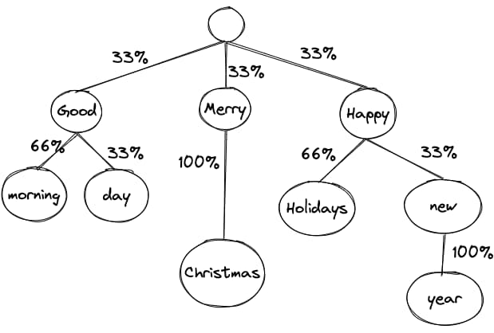
Text Generation – Classical NLP Pipeline
*https://www.sitepen.com/blog/exploring-the-creative-possibilities-of-markov-chains-for-text-generation

Slide 3
Text Generation – Some Features
Few preprocessing, as we want to generate text that contains tokens such as stop words and punctuation.
Some hyperparameters such as number of n-grams to consider when predicting next word.
Sample over k-words can also be tweaked.

Slide 4
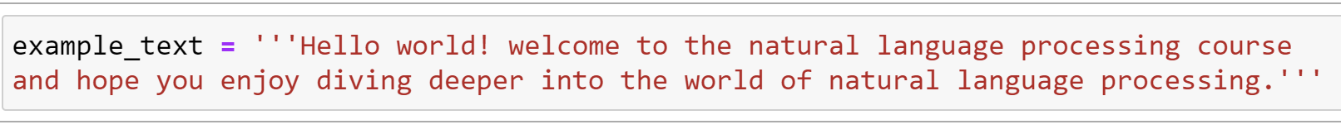
Text Generation – Example

Slide 5
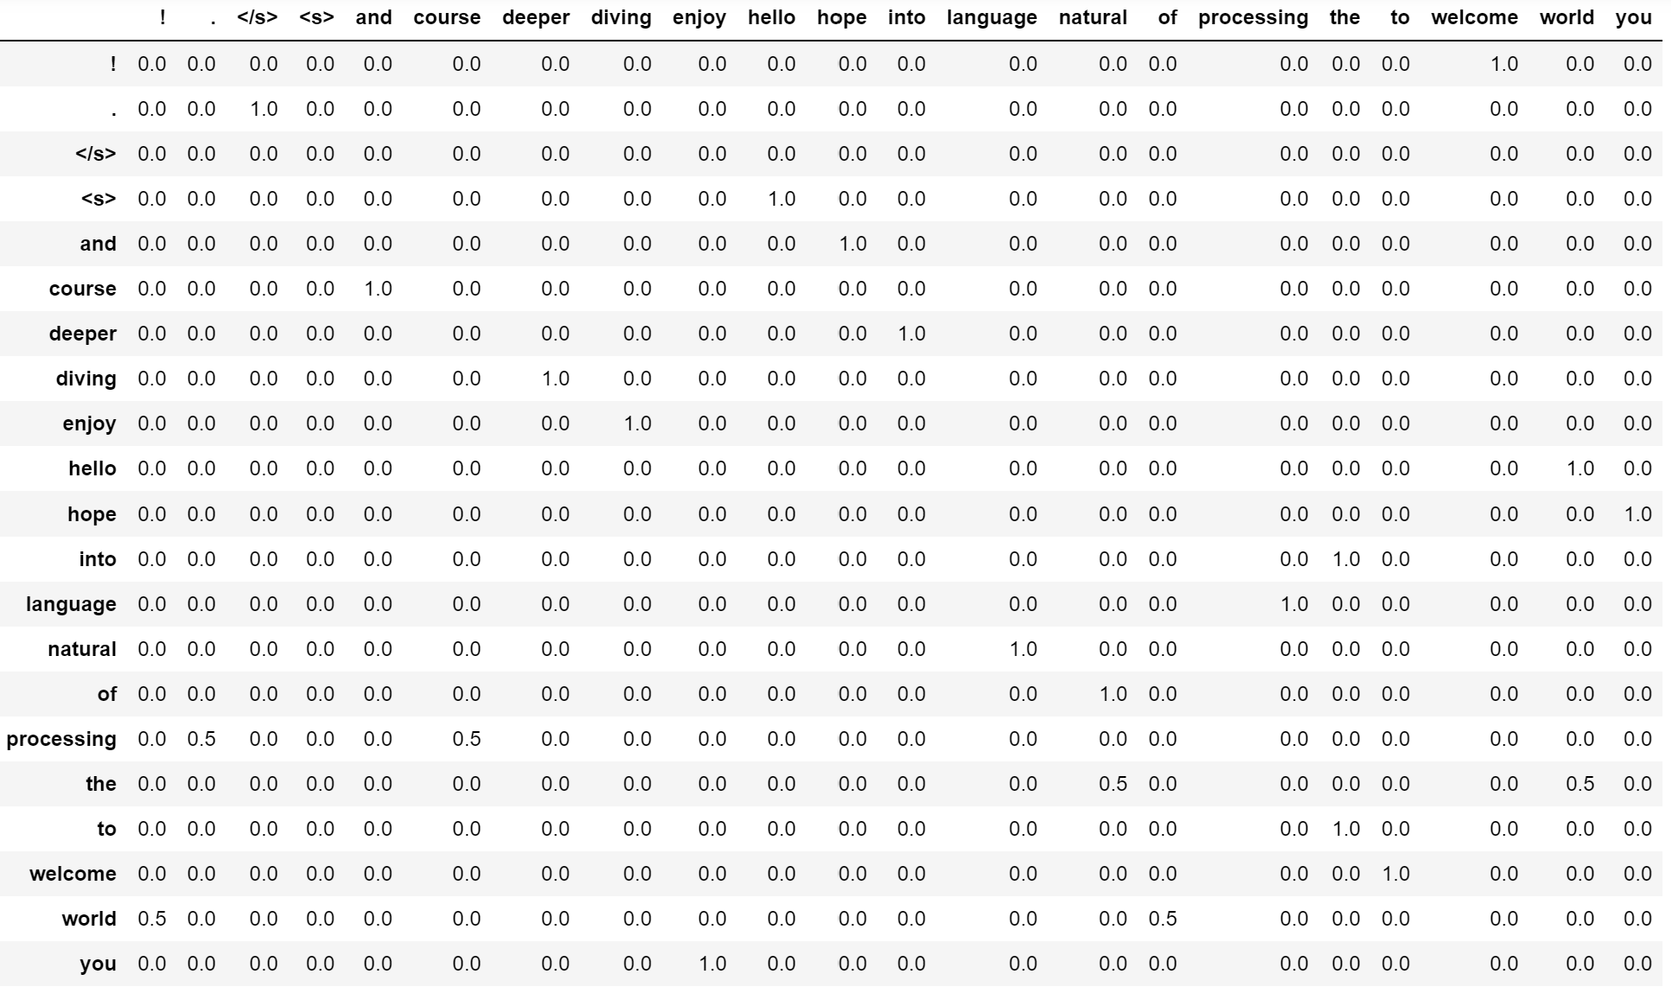
Text Generation – Transition Matrix

Slide 6
Text Generation – Transition Matrix

Slide 7
Text Generation – We can Use n-grams here:

Slide 8
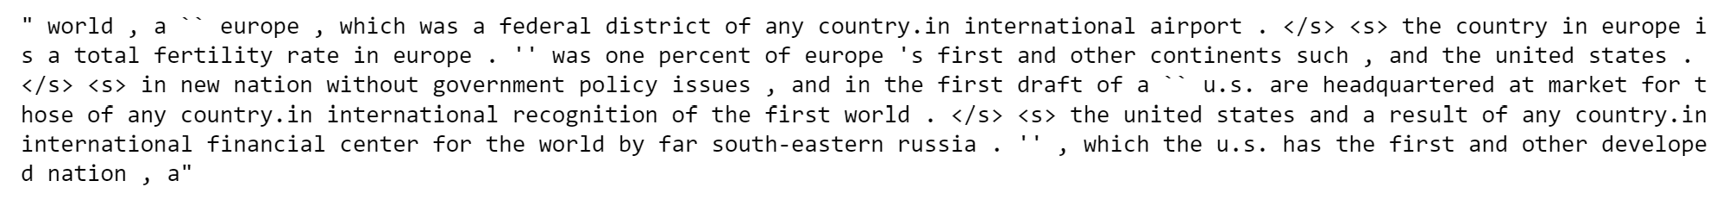
Text Generation – Example of Generated Text

Slide 9
Text Generation – Main Issues
Hard to avoid repetition.
Hard not to produce gibberish.
Very hard to deal with out-of-vocab words.
Markov chains suffer from classical NLP pipelines issues.

